Slide 1
Taxonomic Classification of Short Metagenomic Reads
Sarah Nadeau

Slide 2



The goal: taxonomic inference of short DNA sequences
150 bases

Slide 3
Much larger reference genomes are available
700,000 bases
Genome A
Genome B
150 bases
Notes:
Chose species from a particular taxa with differing degrees of relatedness
Broke genomes down into k-mers
Stored k-mers in hash table (dictionary)

Slide 4
I’m trying to embed k-mers as vectors such that k-mers from the same genome are grouped…
Genome A
Genome B
Notes:
Similar to Natural Language Processing, embed k-mers(words) as vectors and input to machine learning algorithm.
Use triplet network which takes three samples and outputs the distances between each of two samples and the third
Loss function ensures that the network learns to embed 2 samples from the same genome close to each other and a third sample from another genome far away

Slide 5
... And so that short reads can be classified
Genome A
Genome B
Unclassified Short Read
Notes:
Similar to Natural Language Processing, embed k-mers(words) as vectors and input to machine learning algorithm.
Use triplet network which takes three samples and outputs the distances between each of two samples and the third
Loss function ensures that the network learns to embed 2 samples from the same genome close to each other and a third sample from another genome far away

Slide 6
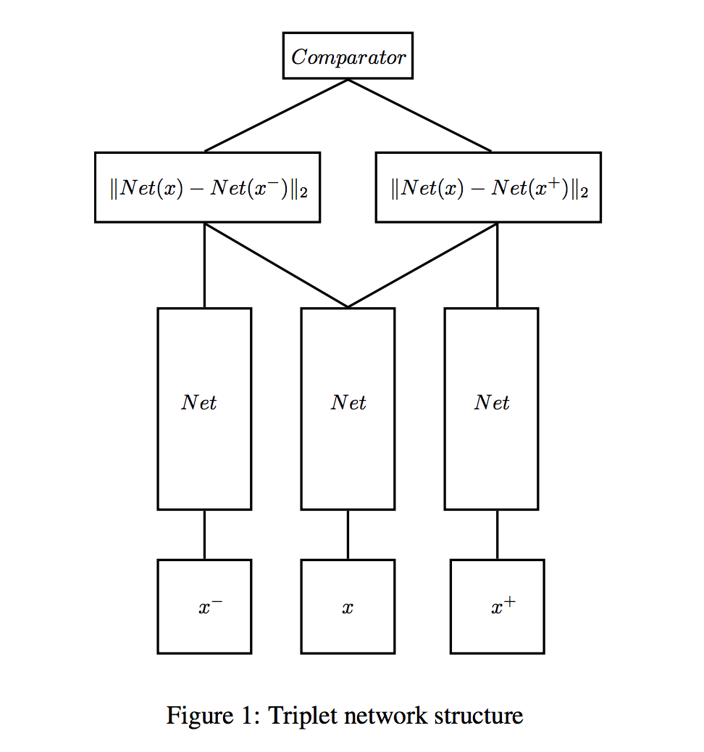
Triplet Network Hoffer & Ailon, 2014

Slide 7
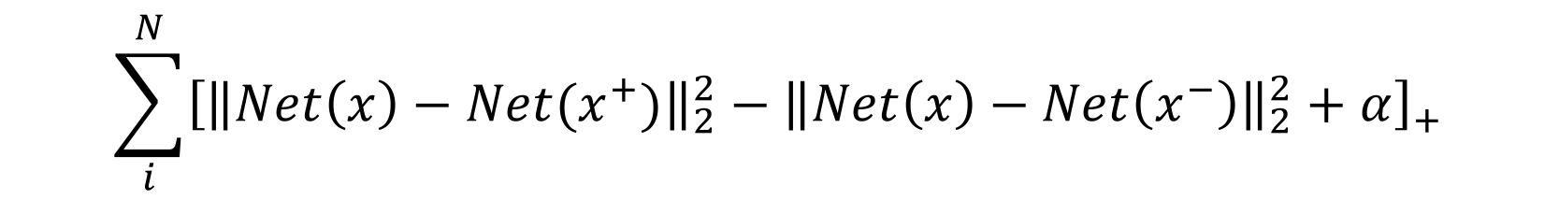
Triplet Loss Schroff et al., 2015
$$\sum_{i}^{N}{{\left[{\left\|Net\left(x\right)−Net(x^{+})\right\|}_{2}^{2}−{\left\|Net\left(x\right)−Net\left(x^{−}\right)\right\|}_{2}^{2}+α\right]}_{+}}$$

Slide 8
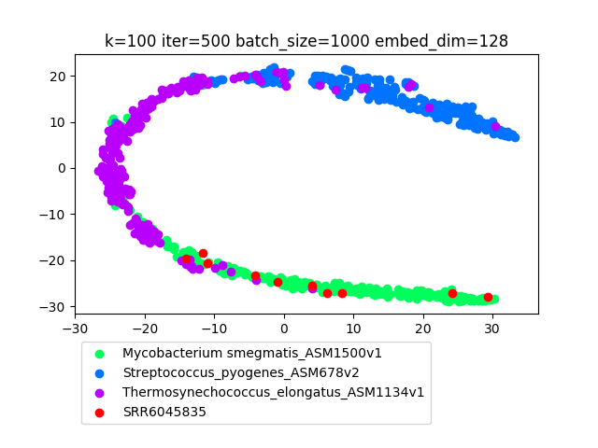
Current Result
Triplet Test Losses

Slide 9
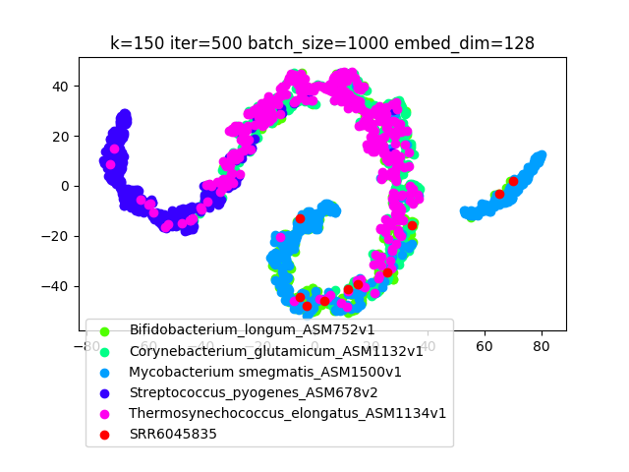
Method breaks down with addition of more genomes

Slide 10
Relatedness of genomes may be a factor in embedding difficulty
Euclidean distance between average embedding
Triplet test losses

